Slide 1
Vulnerability Assessment and Penetration Testing (VAPT)
Name – Parth Mandaliya
Silver Oak University M-tech Sem 2
Enrolment No. 2201071400002

Slide 2
iNTRODUCTION
Importance of penetration testing
Differentiating between vulnerability assessment and penetration testing
Need for a penetration testing framework
A brief introduction to Metasploit
Understanding the applicability of Metasploit throughout all phases of penetration testing
Introduction to supporting tools that help extend Metasploit's capabilities

Slide 3
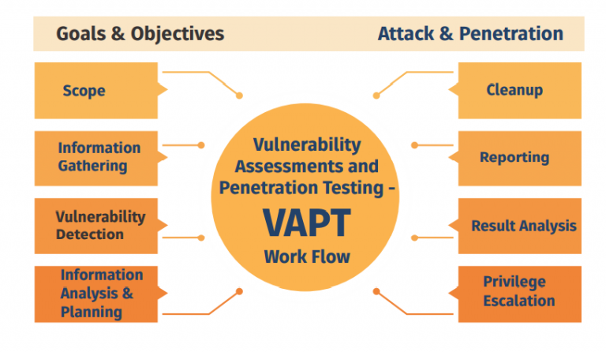
vapt

Slide 4
Vulnerability Assessment
A vulnerability assessment is the process of identifying, classifying, defining and prioritizing vulnerabilities in computer systems, applications or network infrastructures, and report to the organization with the necessary knowledge regarding risk and impact of the vulnerability
A vulnerability can be defined in two ways: ▪ A bug in code or a flaw in software design that can be exploited to cause harm; Exploitation may occur via an authenticated or unauthenticated way. ▪ A gap in security procedures or a weakness in internal controls that when exploited, results in a security breach.

Slide 5
Vulnerability Lifecycle
Discovery – Vul Found by researcher
Disclosure – Vul Disclosed (Privately or Publicly)
Analysis – Is it Exploitable ? / Remotely
Exploit Development – Let’s Write code
Testing – Let’s tests the exploit in diff systems with existing vul
Release – Let’s Release the exploit

Slide 6
Penetration Testing
Penetration testing (or pen testing) is a security exercise where a cyber-security expert attempts to find and exploit vulnerabilities in a computer system. The purpose of this simulated attack is to identify any weak spots in a system’s defenses which attackers could take advantage of.

Slide 7
Penetration testing cycle
Information Gathering: Scan and look for Vul or MissConfig - Active and Passive Info-Gathering.
Enumeration: Filter out MissConfig or outdated version - Services, users, shares, DNS Entries, etc.
Gaining Access: try entering into the system - Bypass security controls; IDS, IPS, Firewall,
Privilege Escalation: Be limitless with Admin Privileges - full control of the system,
Maintaining Access: Persistent Connection - backdoor, malware
Covering Trace: clear records, delete temp created accounts - delete tools, exploits, backdoors, etc.. (as per the agreement)

Slide 8
Importance of pt
Basic security measures are not enough.
Firewalls or anti-virus solutions are not sufficient to protect against attacks.
Security budget; Unlike MNCs, Organizations do not have the budget to implement everything.
There is limited or no resource for security expertise.
What VAPT adds value to is to streamline what is needed for the organization.
Reputation; a small data breach can ruin organization’s reputation. ▪ Potential clients or business partners will feel insecure on collaboration.
Contributing factors can be issues like safeguard of important data. ▪ Organizations also lose out on potential/existing business.

Slide 9
PT types
Black Box Pen Testing: In a black box penetration test, no information is provided to the tester at all. The pen tester in this instance follows the approach of an unprivileged attacker, from initial access and execution through to exploitation. This scenario can be seen as the most authentic, demonstrating how an adversary with no inside knowledge would target and compromise an organization. However, this typically makes it the costliest option too.

Slide 10
Pt types
Grey Box Pen Testing: In a grey box penetration test, also known as a translucent box test, only limited information is shared with the tester. Usually this takes the form of login credentials. Grey box testing is useful to help understand the level of access a privileged user could gain and the potential damage they could cause. Grey box tests strike a balance between depth and efficiency and can be used to simulate either an insider threat or an attack that has breached the network perimeter.

Slide 11
Pt types
White Box Pen Testing: White box penetration testing, sometimes referred to as crystal or oblique box pen testing, involves sharing full network and system information with the tester, including network maps and credentials. This helps to save time and reduce the overall cost of an engagement. A white box penetration test is useful for simulating a targeted attack on a specific system utilizing as many attack vectors as possible.

Slide 12
Thank you

